Slide 1
Making this resource work for you
Prior to teaching this lesson, please refer to the ‘Unit Overview and Planning Document’.
Further guidance on planning Science Mastery lessons can be found in the detailed planning guidance document.
Refer to the ‘notes’ section on each slide for useful information, including suggested expositions, pedagogical content knowledge, suggested questions, answers and more. Consider using presenter mode so you can see this guidance throughout the lesson.
The introduction slides can be adapted to suit your teaching style and the needs of your class.
Before the lesson, adapt the fix-it slide to address any misconceptions identified in the previous lesson’s exit ticket.
Choose from the suggested activities to suit your class. The intention is not that you complete all of these, but that you select those which ones are most appropriate for your students. It may be appropriate to further adapt activities for your students.
These lessons are designed to occupy approximately 1 hour. To adapt for a shorter or longer lesson duration we advise you to adapt the activity section accordingly.
Please consider using the final slide to send feedback about this lesson or examples of PowerPoints that you have adapted to our design team. Your feedback is used to improve Science Mastery for all of our teachers and students. We appreciate all suggestions and comments.
Thank you for reading!
The Science Mastery Team

Slide 2
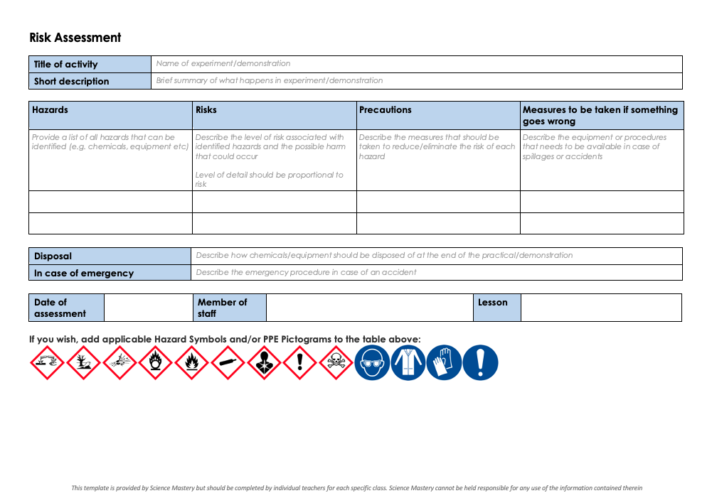
Practical Activity
This lesson contains a practical activity (either a whole class activity or a demonstration)
A risk assessment must be completed for this practical
The template risk assessment can be found here.
The risk assessment should be specific to the class involved and written only by the teaching member of staff
The risk assessment should refer to the current CLEAPSS Hazcards for all chemicals used in the practical for safety and disposal notes.
A list of chemicals used can be found in the Practical Guide
It is good practice for students to wear safety spectacles during all class practicals and demonstrations
Thank you for reading!
The Science Mastery Team

Slide 3
Osmosis Investigation
Answer the questions below.
Define osmosis.
Name the type of membrane required for osmosis to take place.
Describe the difference between a hypertonic and a hypotonic solution.
State the SI unit of mass.
Describe the difference between mass and weight.
The movement of water molecules from a dilute solution to a concentrated solution through a partially permeable membrane.
A partially permeable membrane
A hypertonic solution has a higher solute concentration than a cell/sample and a hypotonic solution has a lower solute concentration than a cell/sample.
Kilograms (kg)
Mass is the amount of matter in an object and weight is the effect of gravity on the mass.
Notes:
Foundation: What is an independent variable?
Stretch: A student investigates the effect of different salt water concentrations on the mass of a potato. Identify the independent and dependent variables.
Answers:
Foundation: The thing that is changed in an experiment.
Stretch:
Independent = salt water concentration
Dependent = mass of potato

Slide 4
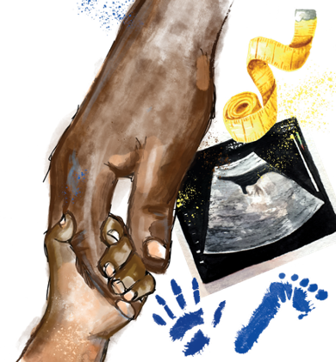
B3.1.10
04/11/2024
Osmosis Investigation
B3.1.1 Prior Knowledge Review
B3.1.2 Eukaryotic and Prokaryotic Cells
B3.1.3 Aseptic Technique
B3.1.4 Growth of Bacteria
B3.1.5 Microscopes
B3.1.6 Observing Cells
B3.1.7 Diffusion
B3.1.8 Diffusion in Living Things
B3.1.9 Osmosis
B3.1.10 Osmosis Investigation
B3.1.11 Active Transport
B3.1.12 Cell Division
B3.1.13 Cancer
B3.1.14 Stem Cells
Notes:
Big Idea: Cells are alive
In this lesson pupils will apply their new learning of the process of osmosis to investigating it in action.
Suggested Hook:
Ask pupils if they prefer chips that are more crunchy or more fluffy inside. Chip consistency can be altered by placing the potatoes in different concentrations of salt solution before cooking which determines how much water is inside the chip cells.

Slide 5

Following this lesson, students will be able to:
State the independent, dependent and control variables of the investigation
Describe the movement of water by osmosis when a potato is placed in different solutions
Explain how to determine the starting concentration of the potato
Key Words:
osmosis
dilute
concentrated
variables
hypotonic
hypertonic

Slide 6
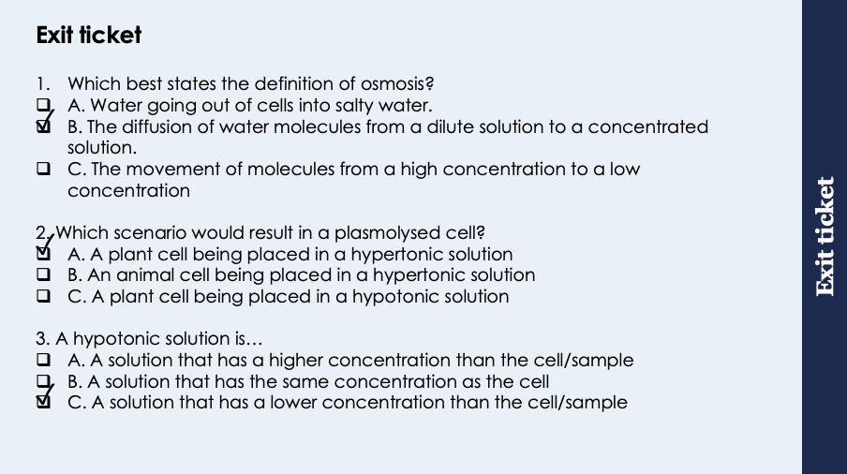
This is the fix-it portion of the lesson
The fix-it is an opportunity to respond to gaps in knowledge, especially those identified by the previous lesson’s exit ticket.
The teacher should customise this slide as needed, to facilitate
reteach, explanation, demonstration or modelling of ideas and concepts that students have not yet grasped or have misunderstood.
practise answering specific questions or of key skills.
redrafting or improving previous work.
Notes:
Purpose: to spend time on gaps identified in previous lesson’s exit ticket.
Answers:
Q1. Answer: B
If pupils answered A they have given an example of when diffusion happens not a definition, if they have answered C they have not got the correct idea of water concentration. To fix this ask pupils to write the definition for osmosis and explain the difference between osmosis and diffusion.
Q2. Answer: A
If pupils answered B they have not appreciated that animal cells do not become turgid. For both answers B and C the incorrect kind of solution has been identified. To fix this get pupils to draw hypotonic, hypertonic and isotonic solutions with cells in and then identify the direction of water movement.
Q3. Answer: C
If pupils answered incorrectly they do not know the difference between the types of solution. To fix this get pupils to draw hypotonic, hypertonic and isotonic solutions with cells in and then identify the direction of water movement.

Slide 7
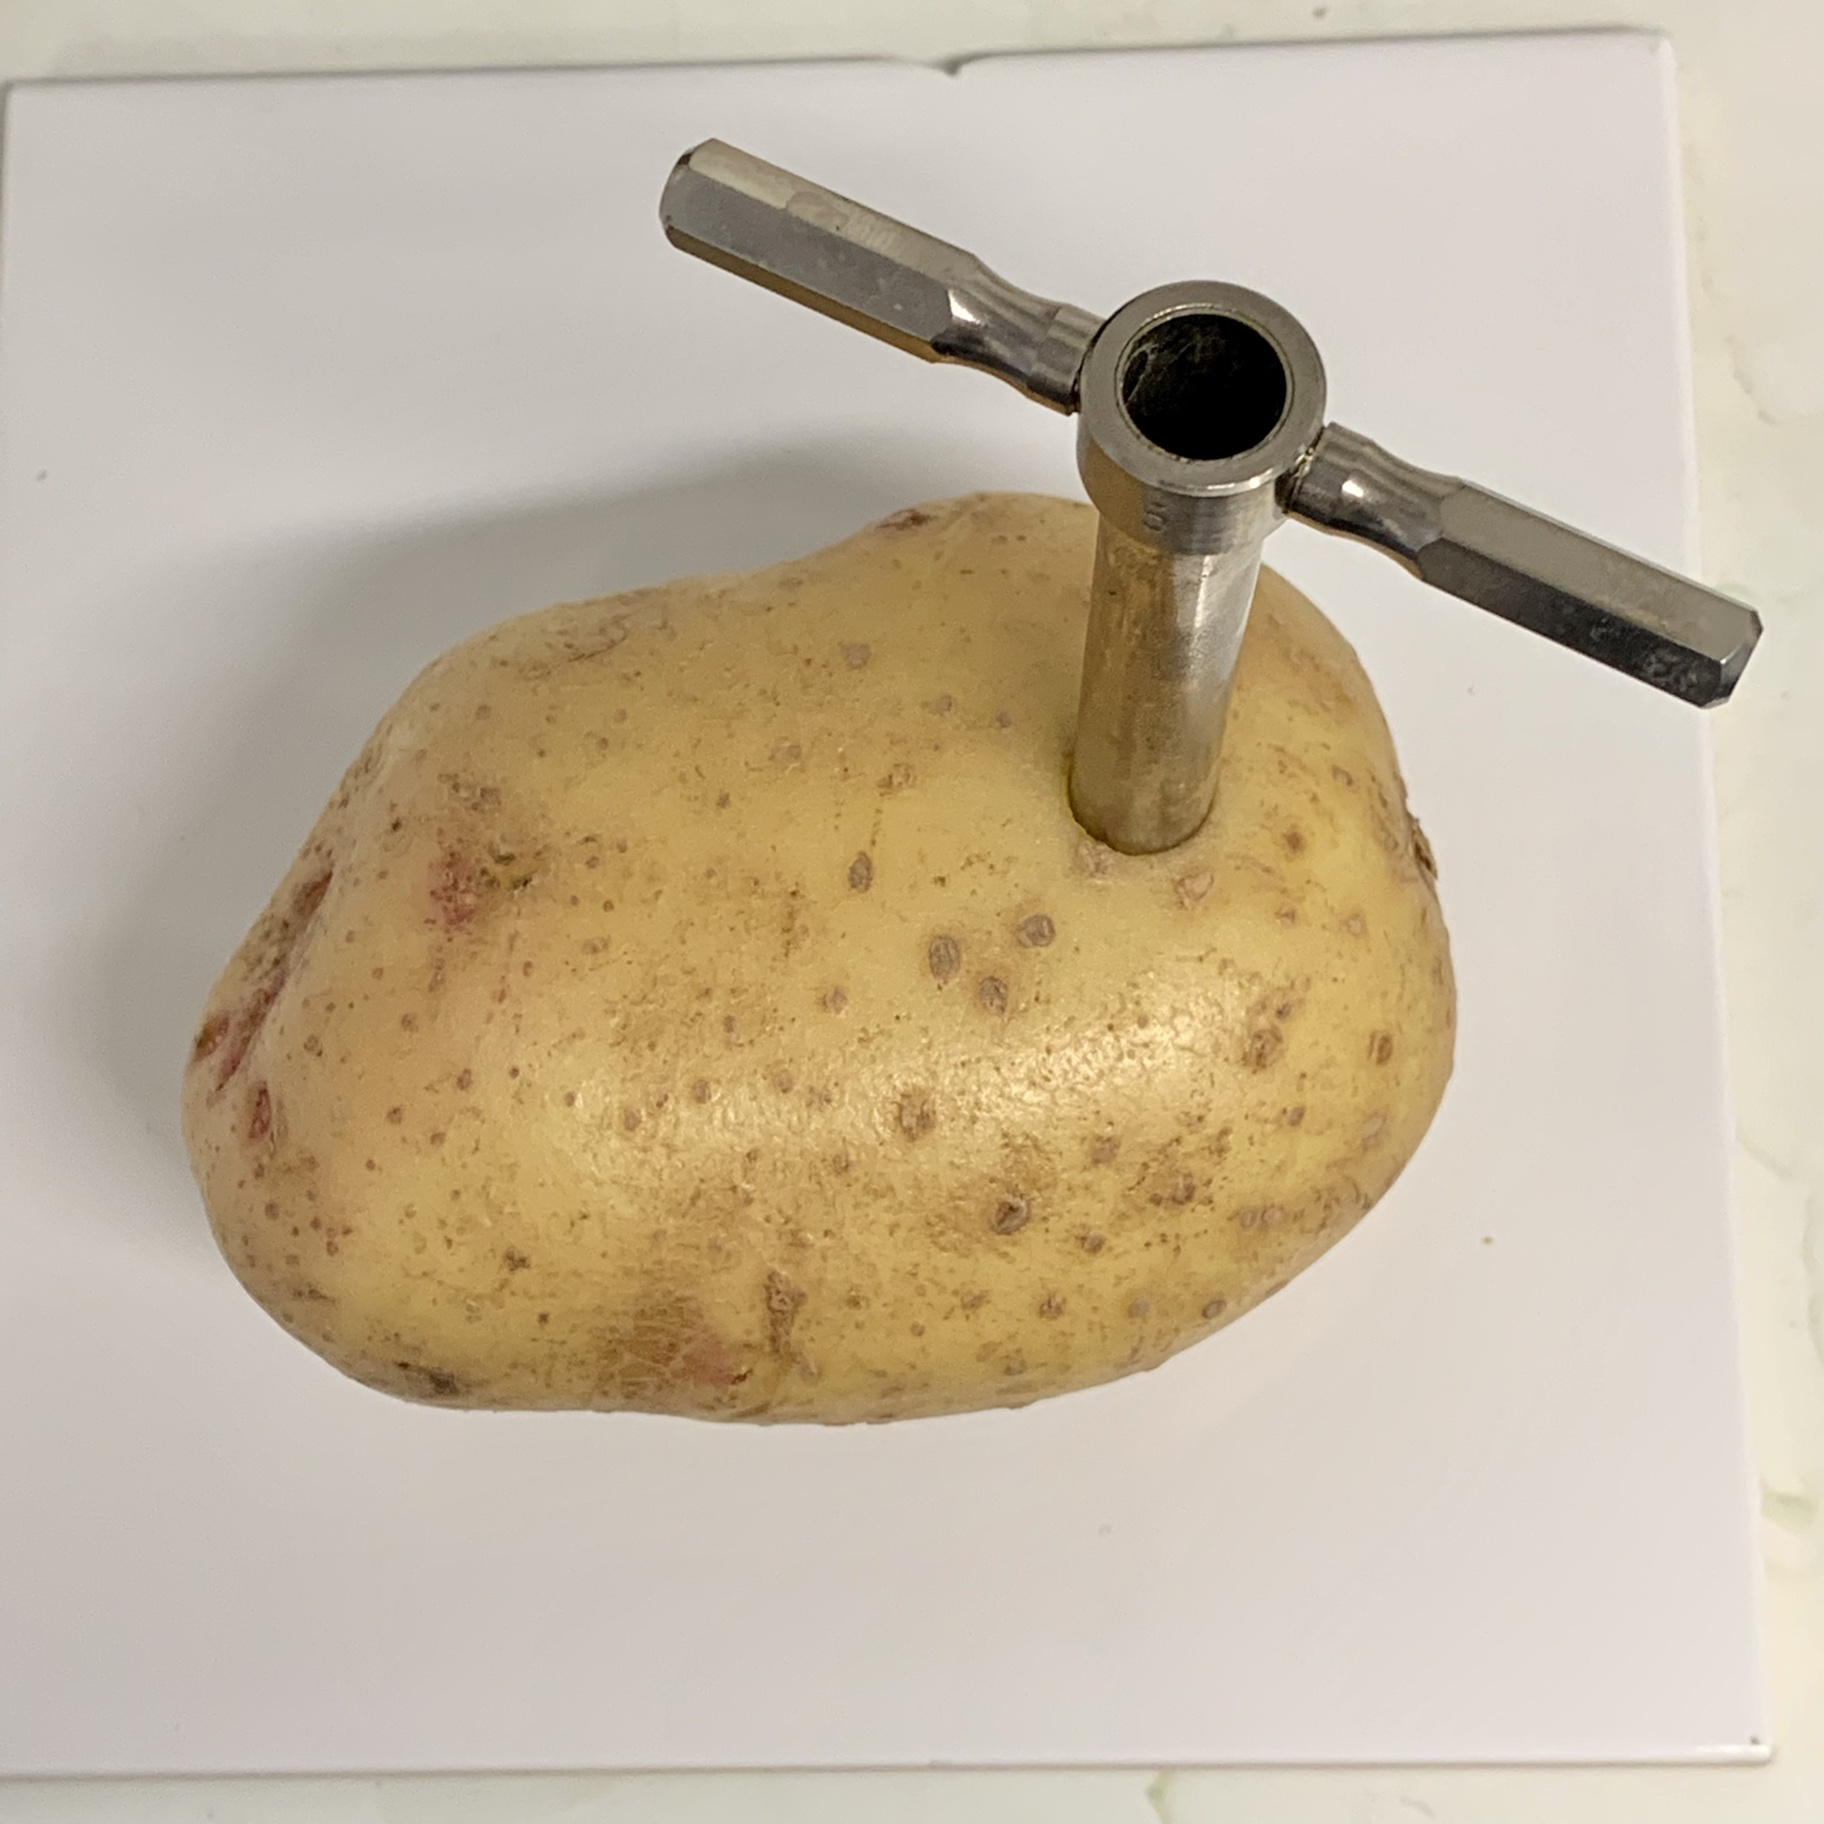
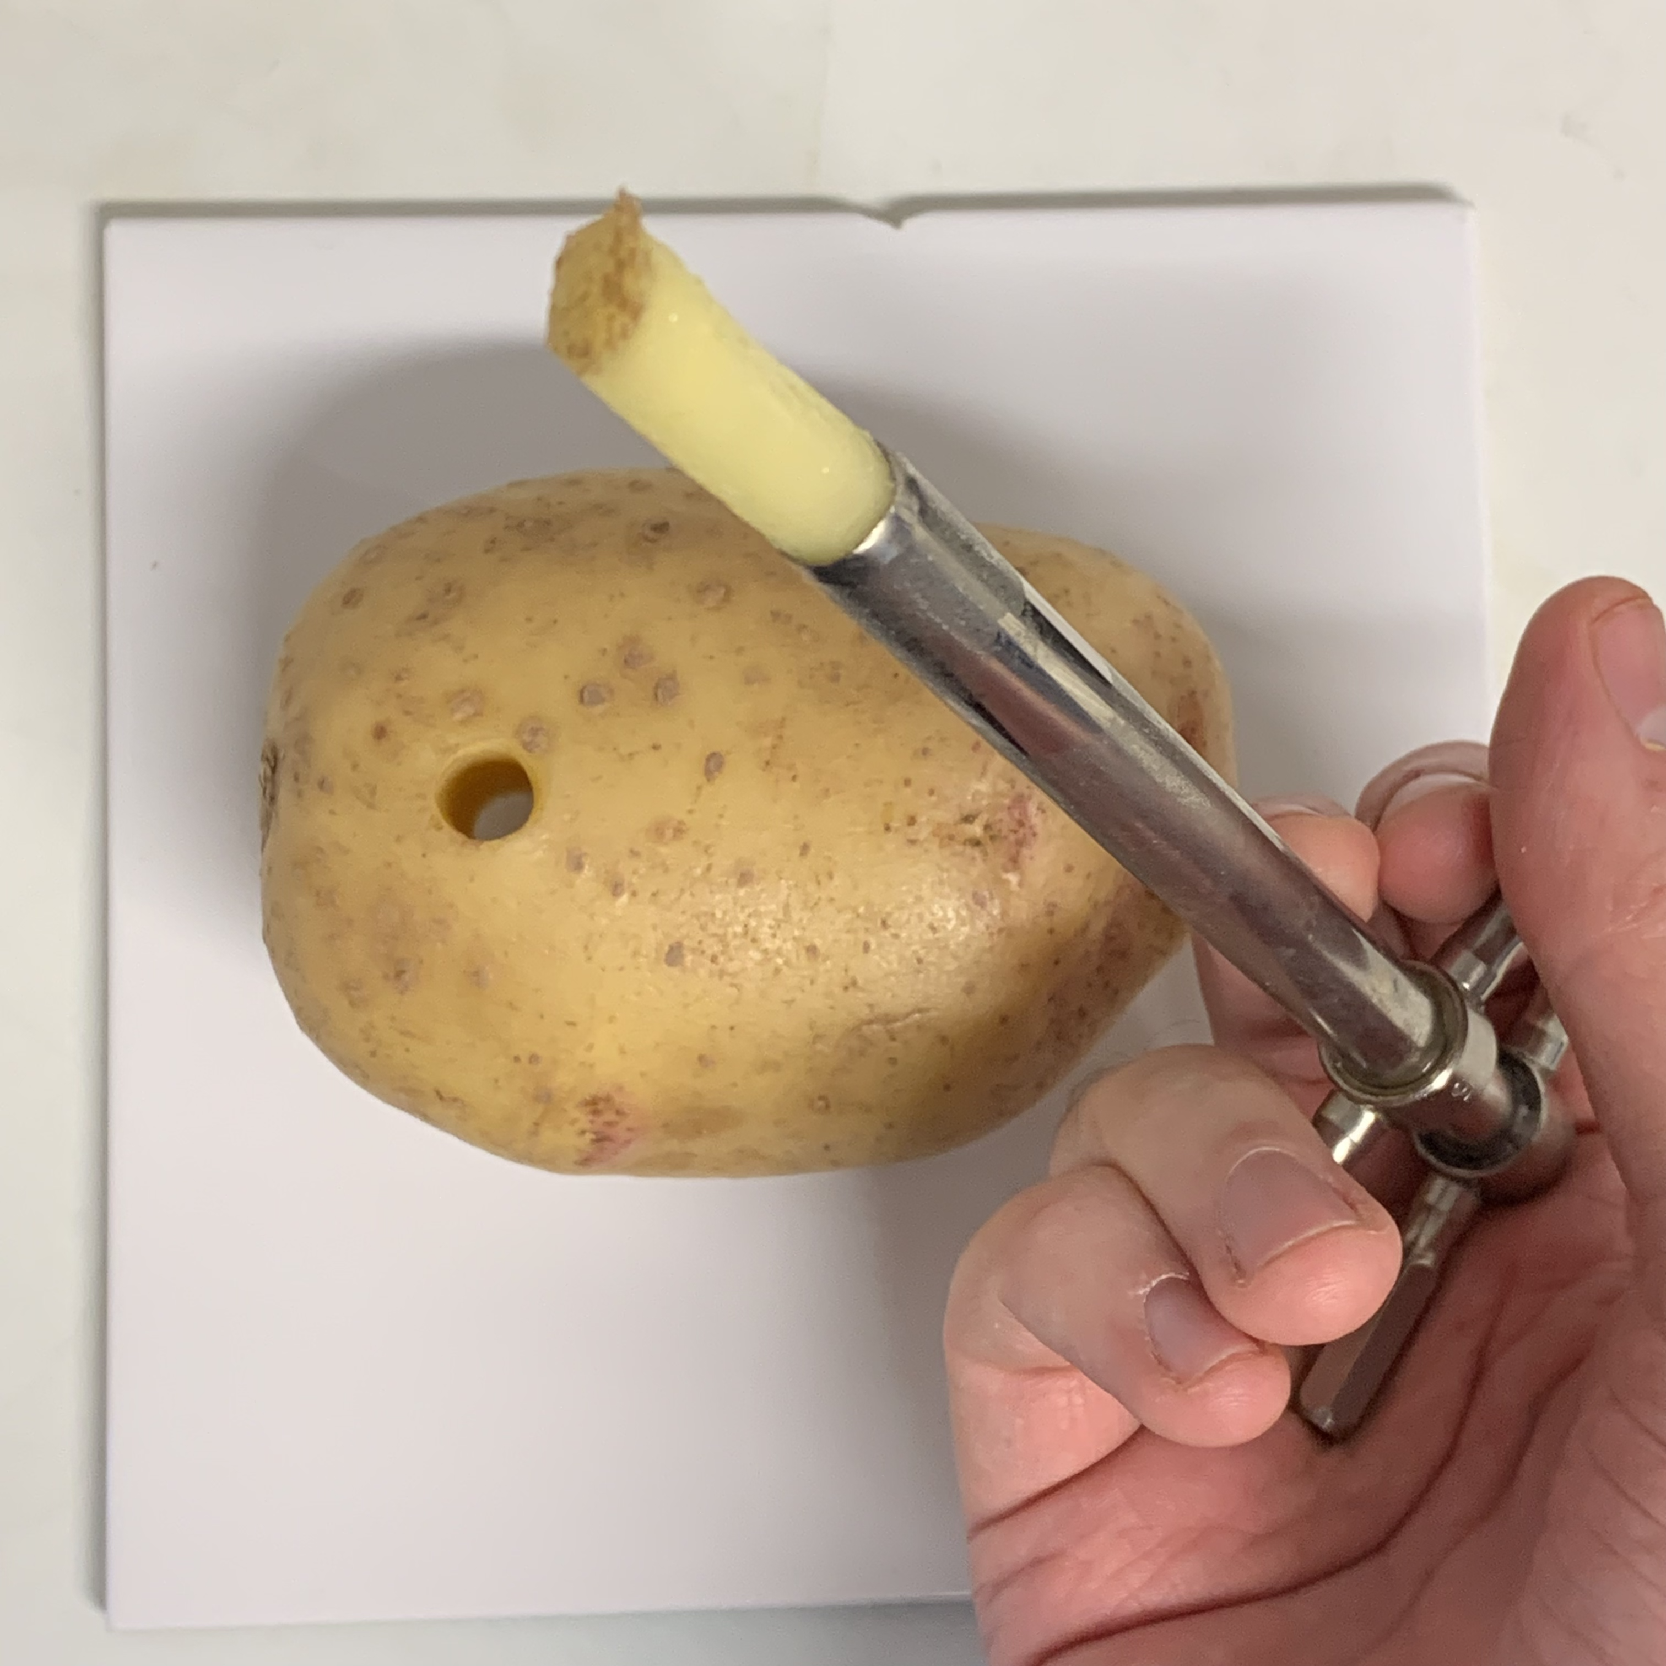
Osmosis Practical
We can use the idea of osmosis to look at relative concentrations of solutes within plant cells
What would happen to pieces of potato if they were put into hypotonic or hypertonic solutions?
Notes:
Purpose: introducing new knowledge
Type of exposition: Explanation
Suggested script:
Now that we know about osmosis, we can look to investigate the concentrations of different solutes (eg salts or sugars) in plant cells. We can place pieces of plant material in solutions of varying concentrations and work out whether those solutions are hypertonic, hypotonic or isotonic compared with the plant tissue. What would you expect to happen to pieces of potato if they were put into a hypotonic solution? Water from the solution would move via osmosis into the potato so the potato would gain mass. What about in a hypertonic solution? In a hypertonic solution water would move out of the potato via osmosis so the potato would lose mass.
The image shows a borer used to cut cylinders of plant tissue. The cylinders can then be cut to the same length, this ensures the samples of plant tissue would all have the same shape and therefore surface area. Important as we know from previous lessons that surface area is a factor that will affect the rate of diffusion and therefore osmosis.
Relative = compared to each other
Teacher subject knowledge : https://www.thoughtco.com/selectively-permeable-4140327

Slide 8

We will be investigating the effect of changing concentrations of salt solutions on the mass of potato tissue. Is this correct?
In this investigation, the dependent variable is the concentration of salt solutions.
Notes:
Answer: this is incorrect because the DV is the mass of potato tissue.
Suggested guidance: After discussion, briefly recap the difference between independent, dependent and control variables.
Then, ask students to write the IV, DV and CVs for this investigation into their books – go through on whiteboard.
IV – concentration of sugar solution
DV – mass of plant tissue
CV – temperature, volume of solution, initial size of potatoes (e.g. length, mass, surface area)
Suggested guidance:
Talk tasks can be used in a variety of ways to suit the particular needs of the students you are teaching. Through exchanging views with others, students develop their understanding of the science beyond what could be achieved individually.
Science classrooms that successfully integrate talk have the following features:
Science talk is a regular feature of lessons and is woven into classroom activities.
Students are paired or grouped strategically by the teacher to ensure productive interaction. This might take into consideration the students’ proficiency of the English language, how encouraging they might be to peers and their attainment in the topic. It’s a good idea to consider these pairings in the class seating plan.
Students are encouraged and supported to talk, but are not forced to talk.
The teacher should take on the role of a facilitator, engaging with conversations where necessary and encouraging or steering the conversation where needed.
Students are encouraged to use the language they have to express their ideas (e.g., everyday language, imperfect English, native language), but also to incorporate science specific terminology where this is more accurate or has been taught.
6. Scientifically inaccurate ideas are not dismissed by the partner or teacher; open discussion and further investigation are relied on to help students construct ideas that support them to progress in their scientific understanding.
7. Guidelines for behaviour during talk tasks are explicit and frequently reviewed. Rules for students might be:
Listen carefully to your partner
Take turns talking.
Speak one at a time, without interrupting.
Politely agree or disagree and explain why.
Politely point out if your partner has used a scientific word incorrectly, if they have explained the science incorrectly, or if there is a more accurate way to describe something.
If confused, ask questions.
Stay focused on the discussion topic.
Respond to one another.

Slide 9



Which statements do you agree with?
I think that the potato placed in a hypertonic solution will increase in mass
I think that the potato placed in a concentrated solution will increase in mass
I think that the potato placed in an isotonic solution will have the same mass at the end
I think that the potato placed in a dilute solution will decrease in mass
Notes:
Answer: Only green is true
Suggested guidance: Use these to get students to write a prediction about what will happen to the potatoes placed in concentrated solutions.
Suggested guidance:
Talk tasks can be used in a variety of ways to suit the particular needs of the students you are teaching. Through exchanging views with others, students develop their understanding of the science beyond what could be achieved individually.
Science classrooms that successfully integrate talk have the following features:
Science talk is a regular feature of lessons and is woven into classroom activities.
Students are paired or grouped strategically by the teacher to ensure productive interaction. This might take into consideration the students’ proficiency of the English language, how encouraging they might be to peers and their attainment in the topic. It’s a good idea to consider these pairings in the class seating plan.
Students are encouraged and supported to talk, but are not forced to talk.
The teacher should take on the role of a facilitator, engaging with conversations where necessary and encouraging or steering the conversation where needed.
Students are encouraged to use the language they have to express their ideas (e.g., everyday language, imperfect English, native language), but also to incorporate science specific terminology where this is more accurate or has been taught.
6. Scientifically inaccurate ideas are not dismissed by the partner or teacher; open discussion and further investigation are relied on to help students construct ideas that support them to progress in their scientific understanding.
7. Guidelines for behaviour during talk tasks are explicit and frequently reviewed. Rules for students might be:
Listen carefully to your partner
Take turns talking.
Speak one at a time, without interrupting.
Politely agree or disagree and explain why.
Politely point out if your partner has used a scientific word incorrectly, if they have explained the science incorrectly, or if there is a more accurate way to describe something.
If confused, ask questions.
Stay focused on the discussion topic.
Respond to one another.

Slide 10
Osmosis Practical
Calculating percentage change in mass
If the final number is bigger than the initial number you are calculating a percentage increase
Increase = Final number – Initial Number
% Increase = Increase x 100
Initial number
Example question:
Potato A had an initial mass of 5g and now has a mass of 7.5g. Calculate the percentage increase in mass.
Increase = 7.5 g – 5 g
= 2.5 g
% Increase = 2.5 x 100
5
= 50% increase
Notes:
Type of exposition: Modelling
Suggested Script:
It is difficult and time consuming to gather multiple samples of plant tissue that all have exactly the same mass. Therefore, to allow for this in our results when investigating the effect of solute concentration on osmosis we calculate percentage change in mass of the plant tissue rather than simply the increase/decrease in grams. This will also allow us to compare results between groups to increase the reproducibility of our results.
To calculate percentage change we first have to identify if the mass has increased or decreased. If the mass has increased we find the actual increase by doing the final mass – the initial mass. The result should be a positive number (if negative a decrease has been calculated).
We then use the actual increase and divide it by the initial mass and multiply by 100 to find the percentage increase.
Suggested guidance: Separate teacher guidance for practical, including how to make the different concentrations. Alternative is to use salt solutions.
Try a sample to get estimate results to practice calculating percentage change in mass. May be useful to go through with pupils the first example in their results table and then let them do the rest by themselves following the same steps.

Slide 11
Osmosis Practical
Calculating percentage change in mass
If the final number is smaller than the initial number you are calculating a percentage decrease
Decrease = Initial number – Final number
% Decrease = Decrease x 100
Initial number
Example question:
Potato B had an initial mass of 5 g and now has a mass of 4.5 g. Calculate the percentage decrease in mass.
Decrease = 5 g – 4.5 g
= 0.5 g
% Decrease = 0.5 x 100
5
= 10% decrease
Notes:
Type of exposition: Modelling
Suggested Script:
If the mass has decreased we find the actual decrease by doing the initial mass – final mass. The result should be a positive number (if negative an increase has been calculated).
We then use the actual decrease and divide it by the initial mass and multiply by 100 to find the percentage decrease.
Suggested guidance: Separate teacher guidance for practical, including how to make the different concentrations. Alternative is to use salt solutions.
Try a sample to get estimate results to practice calculating percentage change in mass. May be useful to go through with pupils the first example in their results table and then let them do the rest by themselves following the same steps.

Slide 12
Quick Quiz
Determine whether each statement is true or false:
Osmosis involves a fully permeable membrane
Osmosis is the movement of water from a dilute concentration to a concentrated solution
An independent variable is one which is kept the same during an experiment
A dependent variable is one which is measured during an experiment and plotted on the y-axis
To make an experiment fair it is important to change as many variables as possible
False
True
False
True
False
Notes:
Purpose: assess understanding of new information. Get students to do thumbs up or thumbs down to choose answer. Take consensus with answers and use questioning to explain correct answer and correct false statements.
Answers:
False – partially permeable, so larger molecules cannot pass through
True
False – independent variable is the variable that is changed by the investigator (in this case concentration), variables that are kept the same are control variables
True
False – this is very bad scientific practice, it is important to only change one variable at a time in order to attribute causation

Slide 13
Drill
We will be investigating the effect of changing concentrations of salt solutions on the mass of potato tissue. State the:
Independent variable
Dependent variable
Two control variables
What would happen to the mass of a piece of potato if it was put into a hypotonic solution?
What would happen to the mass of a piece of potato if it was put into a hypertonic solution?
State the equation used to calculate percentage increase.
Name the piece of equipment used to cut cylinders from potato.
Notes:
Purpose: This is a knowledge drill. The purpose of this is to check that the critical knowledge is secure before pupils move onto independent practice.
Suggested guidance: There are a range of ways this could be done depending on time and ability range of the class:
Mini whiteboards
As full sentences in exercise books
As short answers in exercise books
In the pupil workbook
As pair talk
As cold call

Slide 14
Drill answers
The concentration of salt solution
Change in mass of the potato
Any two of the following: Temperature, volume of the salt solution, initial mass of the potato cylinder, initial length of the potato cylinder, amount of time potato cylinders are left in solution for.
Water from the solution would move via osmosis into the potato so the potato would gain mass
In a hypertonic solution water would move out of the potato via osmosis so the potato would lose mass.
% Increase = Increase x 100
Initial number
Cork borer
Notes:
Purpose: This is a knowledge drill. The purpose of this is to check that the critical knowledge is secure before pupils move onto independent practice.
Suggested guidance: There are a range of ways this could be done depending on time and ability range of the class:
Mini whiteboards
As full sentences in exercise books
As short answers in exercise books
In the pupil workbook
As pair talk
As cold call

Slide 15
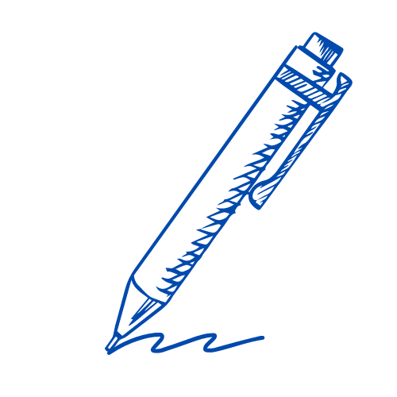
I: Scientific investigation method
Example question:
To ‘explain’ your answer should:
Begin with a scientific statement.
Use ‘this means that’, ‘because’ or ‘so’ to link your statement to the question.
A student investigated the effect of different concentrations of sugar solution on pieces of potato. When the student lifted the potato out of the solution, explain why the student dried each piece of potato before weighing it.
Model answer:
To remove excess water on the outside of the potato
because otherwise this would increase the mass
Notes:
This slide models the process of answering a describe question.
Firstly, students are presented with a generic describe question, along with a model answer. Students are also given some simple guidance to follow for producing their own describe answer.
The generic question and answer should be used by the teacher to remind students of
the key features of a great answer
how to structure their answer
why the model answer is a good example
Following this, students will be required to apply this process to answer their own describe question, which will appear in place of the generic questions. This describe question will be specific to the topic students are learning about in the lesson. Give students time to write their own answer to this, ensuring that they use the guidance provided. To further scaffold this task for students, it may be appropriate to:
pair students up to write an answer together
list for students the key words you would like them to include in the answer
provide a writing frame or ‘points to include’ for students
A model answer for this question will appear. Teachers should review the model answer with students by referencing the guidance in the green box. For example ‘we can see item 1 in the guidance is to use bullet points to keep your answer clear. Notice in the model answer here we have done just that’. Or ‘item 2 in the guidance here says that we should use scientific keywords in the answer. Has this been achieved in the model answer? Where can we see this?’.

Slide 16
We: Scientific investigation method
Example question:
To ‘explain’ your answer should:
Begin with a scientific statement.
Use ‘this means that’, ‘because’ or ‘so’ to link your statement to the question.
In this investigation, percentage change is calculated.
Explain why percentage change is calculated.
Model answer:
plant samples may not have exactly the same mass
using percentage change means we can compare results between different groups
this means our results are more reproducible
Notes:
This slide models the process of answering a describe question.
Firstly, students are presented with a generic describe question, along with a model answer. Students are also given some simple guidance to follow for producing their own describe answer.
The generic question and answer should be used by the teacher to remind students of
the key features of a great answer
how to structure their answer
why the model answer is a good example
Following this, students will be required to apply this process to answer their own describe question, which will appear in place of the generic questions. This describe question will be specific to the topic students are learning about in the lesson. Give students time to write their own answer to this, ensuring that they use the guidance provided. To further scaffold this task for students, it may be appropriate to:
pair students up to write an answer together
list for students the key words you would like them to include in the answer
provide a writing frame or ‘points to include’ for students
A model answer for this question will appear. Teachers should review the model answer with students by referencing the guidance in the green box. For example ‘we can see item 1 in the guidance is to use bullet points to keep your answer clear. Notice in the model answer here we have done just that’. Or ‘item 2 in the guidance here says that we should use scientific keywords in the answer. Has this been achieved in the model answer? Where can we see this?’.

Slide 17
You: Scientific investigation method
Example question:
To ‘explain’ your answer should:
Begin with a scientific statement.
Use ‘this means that’, ‘because’ or ‘so’ to link your statement to the question.
Describe the change which will occur if a piece of peeled potato is placed in a concentrated sugar solution and explain why this change occurs.
Model answer:
The piece of potato will shrink
Because the concentration of sugar is greater in the solution than concentration inside the cell
(or the concentration of water is higher inside the cell than in the solution)
So, water moves out of the cell via osmosis
Notes:
This slide models the process of answering a describe question.
Firstly, students are presented with a generic describe question, along with a model answer. Students are also given some simple guidance to follow for producing their own describe answer.
The generic question and answer should be used by the teacher to remind students of
the key features of a great answer
how to structure their answer
why the model answer is a good example
Following this, students will be required to apply this process to answer their own describe question, which will appear in place of the generic questions. This describe question will be specific to the topic students are learning about in the lesson. Give students time to write their own answer to this, ensuring that they use the guidance provided. To further scaffold this task for students, it may be appropriate to:
pair students up to write an answer together
list for students the key words you would like them to include in the answer
provide a writing frame or ‘points to include’ for students
A model answer for this question will appear. Teachers should review the model answer with students by referencing the guidance in the green box. For example ‘we can see item 1 in the guidance is to use bullet points to keep your answer clear. Notice in the model answer here we have done just that’. Or ‘item 2 in the guidance here says that we should use scientific keywords in the answer. Has this been achieved in the model answer? Where can we see this?’.

Slide 18
Discuss: What would plant cells under the microscope look like after being placed in hypotonic or hypertonic solutions?
Cells in hypotonic solution
Cells in hypertonic solution
Notes:
Guidance:
You can either get students to draw scientific diagrams to show what they think plant cells would look like under a microscope in each case, or you may want to prepare slides so that pupils can actually see the difference for themselves.
Answer:
When plant cells are in hypotonic solution, particles of water have moved into the cell, through the partially permeable membrane. They are swollen and turgid (stiff).
When plant cells are in hypertonic solution, particles of water have moved out of the cell, through the partially permeable membrane. They are shrunken and shriveled. The purple cytoplasm is moving away from the cell wall. Eventually plasmolysis occurs, where the cell membrane has been pulled away from the cell wall and the cell cannot function normally.

Slide 19
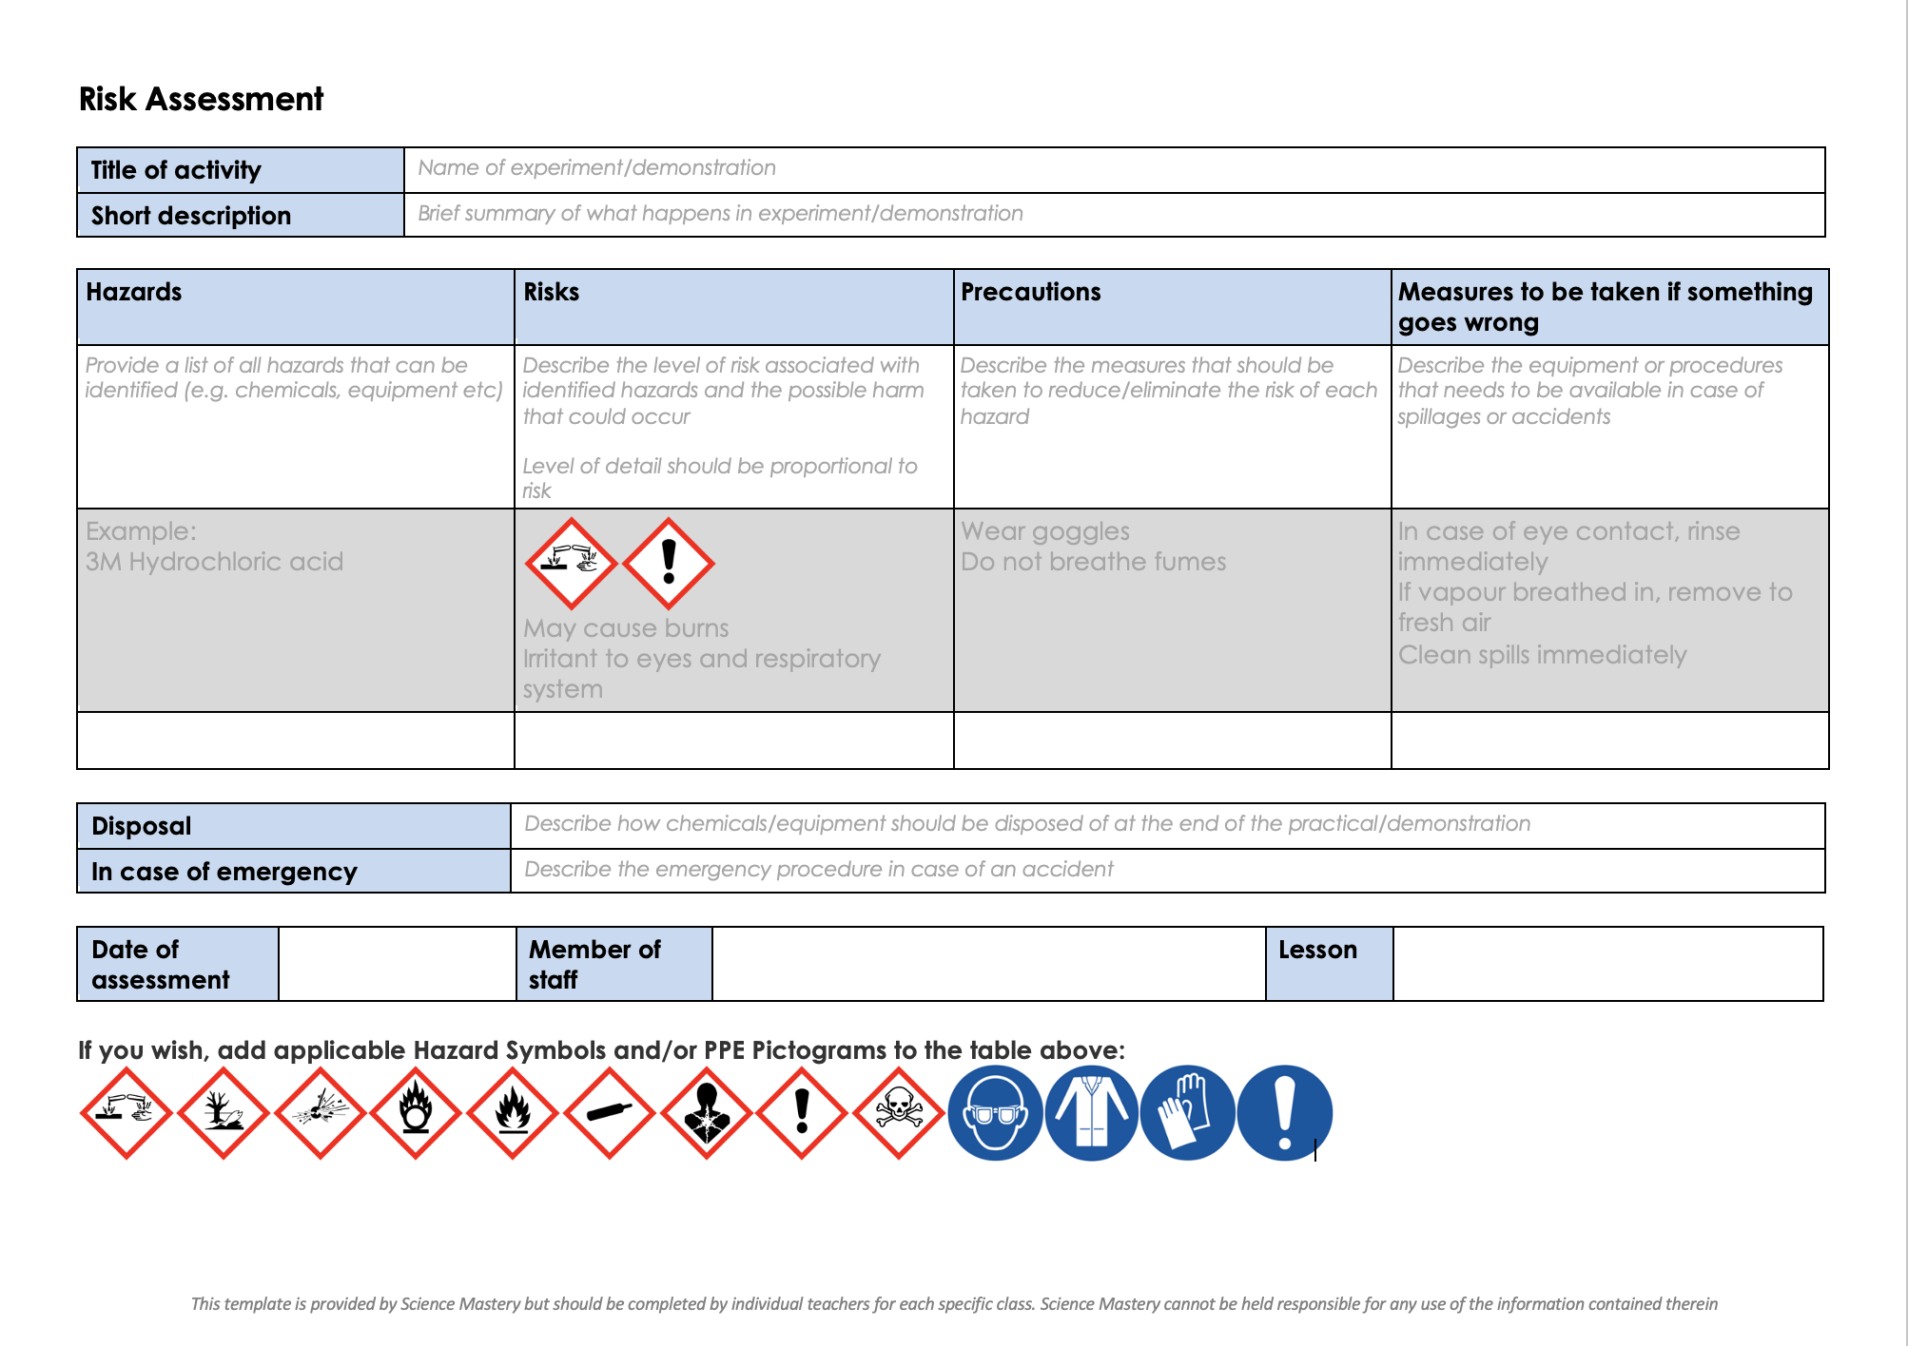
Risk Assessment
A risk assessment must be completed for this practical
The template risk assessment can be found here.

Slide 20
Osmosis
Follow the instructions on the practical sheet to carry out the experiment.
Complete the aim, results and conclusion sections and answer the questions.
salt solution salt solution salt solution salt solution
Notes:
Separate teacher guidance for practical, including how to make the different concentrations. Alternative is to use sugar solutions.
Suggested guidance: Also useful to perform with onion cells and then look at them under the microscope to allow pupils the chance to see plasmolysed and turgid cells – good activity to look at while waiting for the potato cylinders.

Slide 21
I: Interpreting results
A student investigated the effect of different concentrations of sugar solution on the percentage change in mass of potato pieces.
What is the percentage change in mass of potato when placed in 0.1 mol/dm³ sugar solution?
(+)14%
Explain why this would have happened.
Because the concentration of sugar is lower in the solution than concentration inside the potato cells
So, water moves into the cells via osmosis

Slide 22
We: Interpreting results
A student investigated the effect of different concentrations of sugar solution on the percentage change in mass of potato pieces.
What is the percentage change in mass of potato when placed in 0.4 mol/dm³ sugar solution?
-8%
Explain why this would have happened.
Because the concentration of sugar is greater in the solution than concentration inside the potato cells
So, water moves out of the cells via osmosis

Slide 23
You: Interpreting results
A student investigated the effect of different concentrations of sugar solution on the percentage change in mass of potato pieces.
Predict what the change in mass of potato would be when placed in a concentration of 0.25 mol/dm³.
0%
Explain why.
Because this concentration of sugar solution is likely to be the same as the concentration inside the potato cells
So, the net movement of water would be zero

Slide 24
Answer the questions below.
1. What was the independent variable in this experiment?
Mass of potato cylinder
Concentration of salt solution
Change in mass of potato cylinder
2. What would you expect to happen if a piece of onion was left in a hypertonic solution?
The onion would disappear as the cells would lyse
The onion would decrease in mass.
The onion would increase in mass.
3. What would you expect to happen if a sample of animal cells were left in a hypotonic solution?
They would expand and become turgid
They would expand and burst
They would become shrivelled
✓
✓
✓
Notes:
Purpose: to find out if students are able to answer key questions that check for understanding of the new information/skills that have been covered.
Suggested guidance:
Give students thinking time and then ask for feedback – either holding up fingers for the right number/letter, using mini whiteboards or just writing answers down in books quickly before cold calling.
Answers:
Q1. Answer: B
If pupils have answered incorrectly they have mis-identified variables, A and C both link to the dependent variable in the practical (measure A to find C). To fix this give pupils a selection of independent and dependent variables from experiments and ask them to write an aim for each one.
Q2. Answer: B
If pupils have answered they have misunderstood either the types of solution or the effects of different solutions on plant cells. Answer A indicates that pupils have missed that plant cells have a cell wall so become turgid and do not lyse, answer C indicates not understanding the different solutions. To fix this it could be useful to get pupils to draw diagrams of hypertonic, hypotonic and isotonic solutions for plant and animal cells so they can see which direction the water would move in. It may also be useful to go through plant and animal cell structure to show why animal cells burst, while plant cells become turgid etc. Also useful to give relative concentrations so pupils have to work out whether a solution is hypertonic, hypotonic or isotonic.
Q3. Answer: B
If pupils have answered incorrectly they have misunderstood either the types of solution or the effects of different solutions on animal/ plant cells. Answer A indicates that pupils have missed that animal cells do not have a cell wall so lyse instead of becoming turgid, answer C indicates not understanding the different solutions. To fix this it could be useful to get pupils to draw diagrams of hypertonic, hypotonic and isotonic solutions for plant and animal cells so they can see which direction the water would move in. It may also be useful to go through plant and animal cell structure to show why animal cells burst, while plant cells become turgid etc. Also useful to give relative concentrations so pupils have to work out whether a solution is hypertonic, hypotonic or isotonic.

Slide 25
Lesson B3.1.10
What was good about this lesson? | What can we do to improve this lesson?
Send us your feedback by clicking this link
or by emailing sciencemastery@arkonline.org
Thank you!

